Slide 1
Introduction

Slide 2
Uses of Computer Networks
  Business Applications
  Home Applications
  Mobile Users
  Social Issues

Slide 3
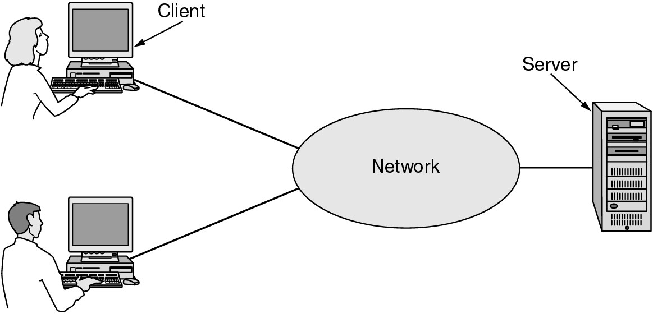
Business Applications of Networks
A network with two clients and one server.

Slide 4
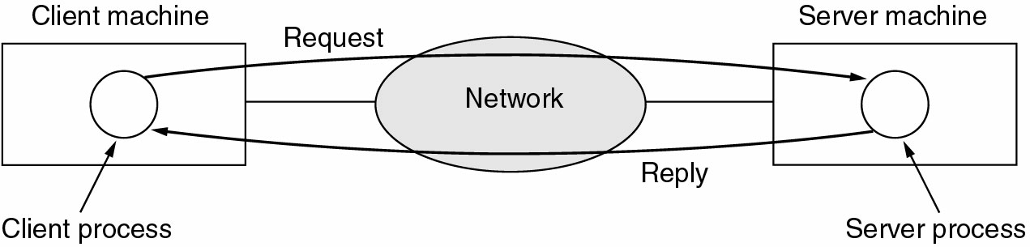
Business Applications of Networks (2)
The client-server model involves requests and replies.

Slide 5
Home Network Applications
Access to remote information
Person-to-person communication
Interactive entertainment
Electronic commerce

Slide 6
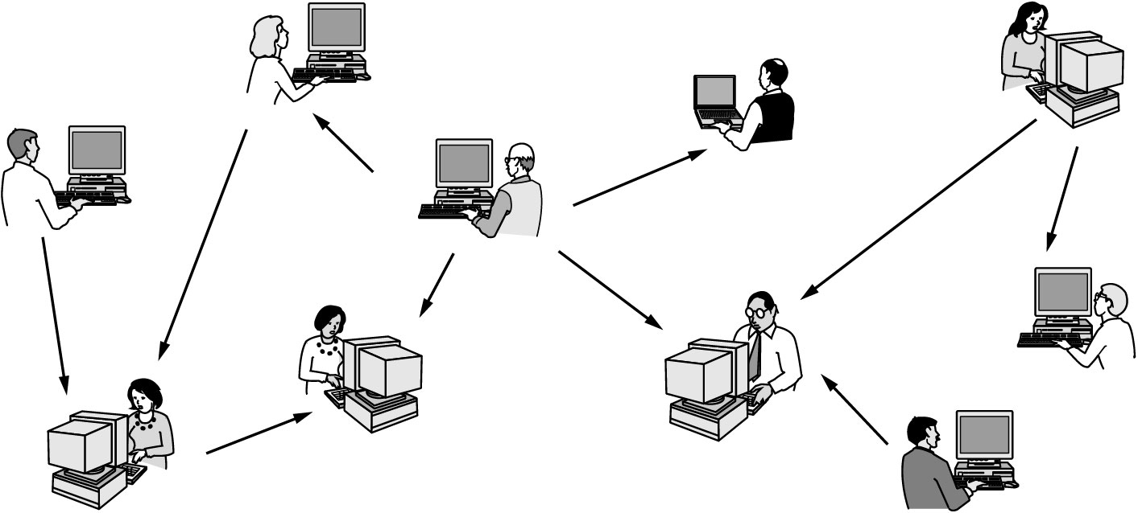
Home Network Applications (2)
In peer-to-peer system there are no fixed clients and servers.

Slide 7
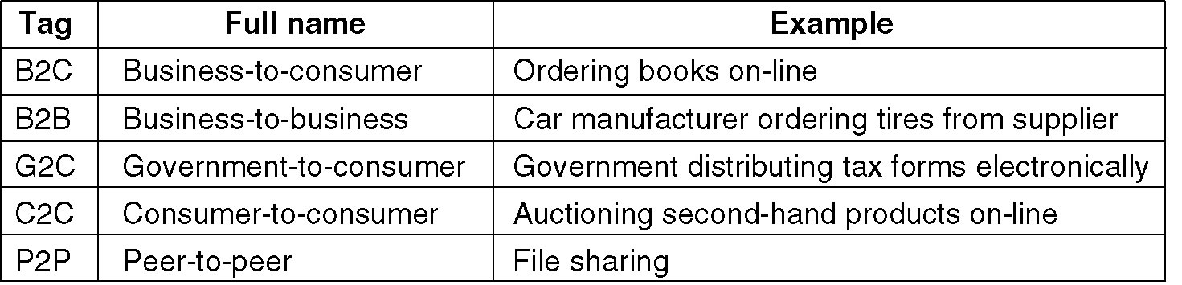
Home Network Applications (3)
Some forms of e-commerce.

Slide 8
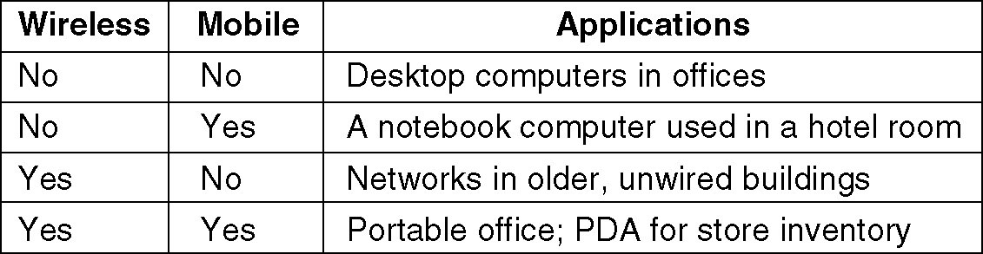
Mobile Network Users
Combinations of wireless networks and mobile computing.

Slide 9
Network Hardware
Local Area Networks
Metropolitan Area Networks
Wide Area Networks
Wireless Networks
Home Networks
Internetworks

Slide 10
Broadcast Networks
Types of transmission technology
Broadcast links
Point-to-point links

Slide 11
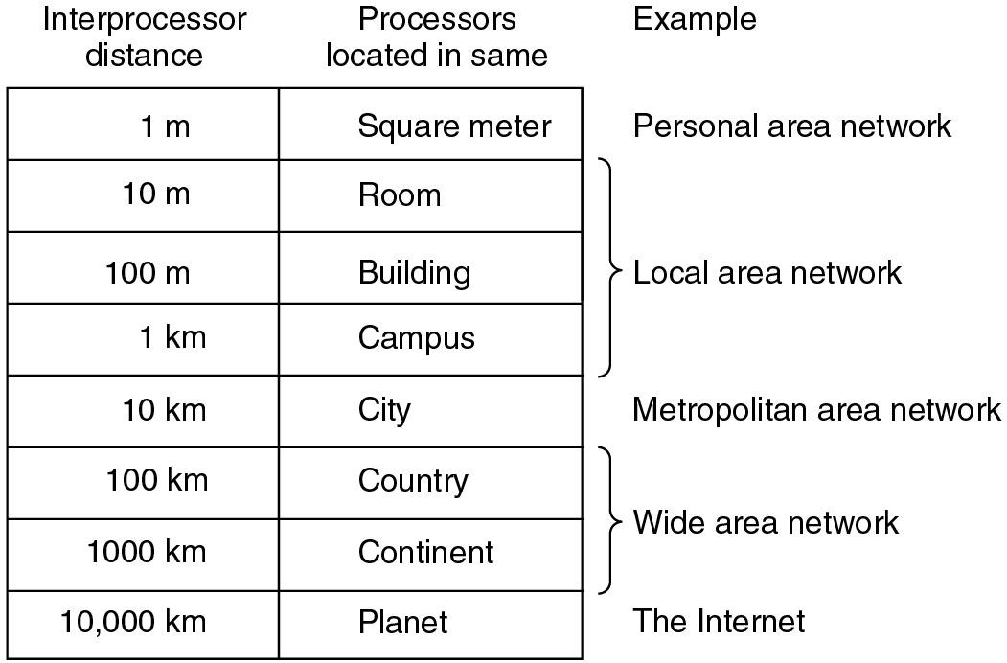
Broadcast Networks (2)
Classification of interconnected processors by scale.

Slide 12
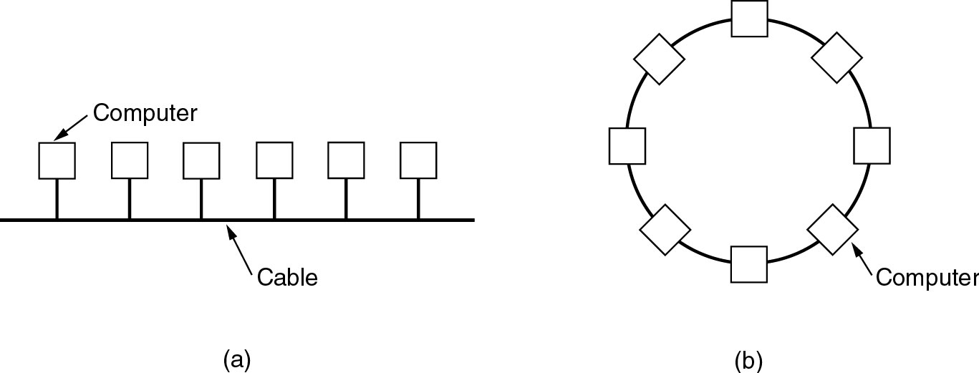
Local Area Networks
Two broadcast networks
(a) Bus
(b) Ring

Slide 13
Broadcast Network
Static and Dynamic
Static – Divide time into discrete intervals,
- Use Round Robin
Disadvantage - wastes channel capacity
Dynamic Allocation
Centralized or Decentralized
Centralized – A Bus Arbitration Unit
Decentralized – No central entity, each machine decides for itself

Slide 14
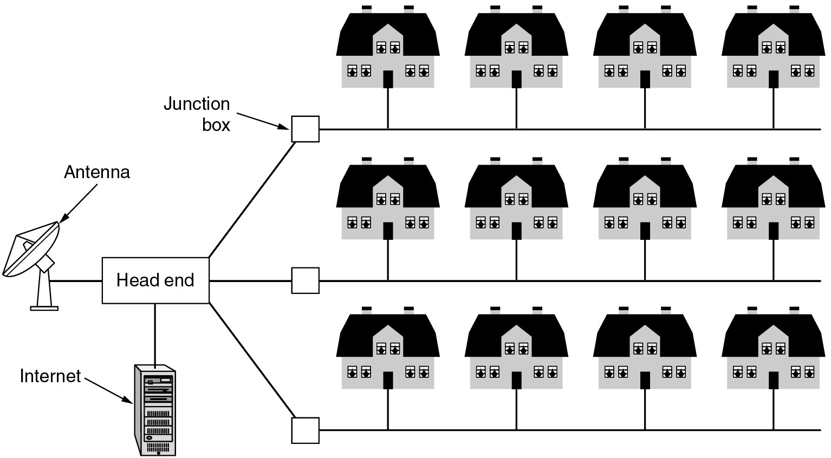
Metropolitan Area Networks
A metropolitan area network based on cable TV.

Slide 15
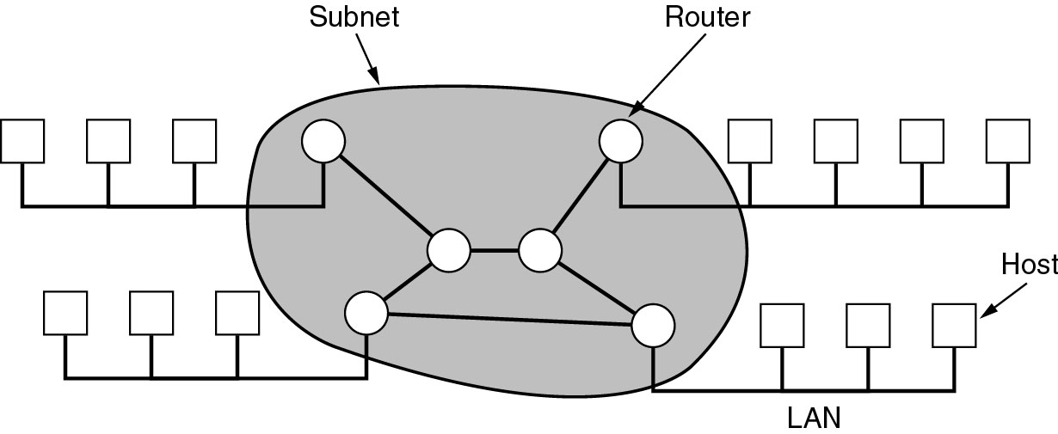
Wide Area Networks
Relation between hosts on LANs and the subnet.

Slide 16
Wide Area Network
Subnet
Transmission Lines – move bits between machines
Switching Elements – Connect three or more transmission lines
(Router)
Subnet – Collection of Communication Lines and Routers
Different from Subnet IP

Slide 17
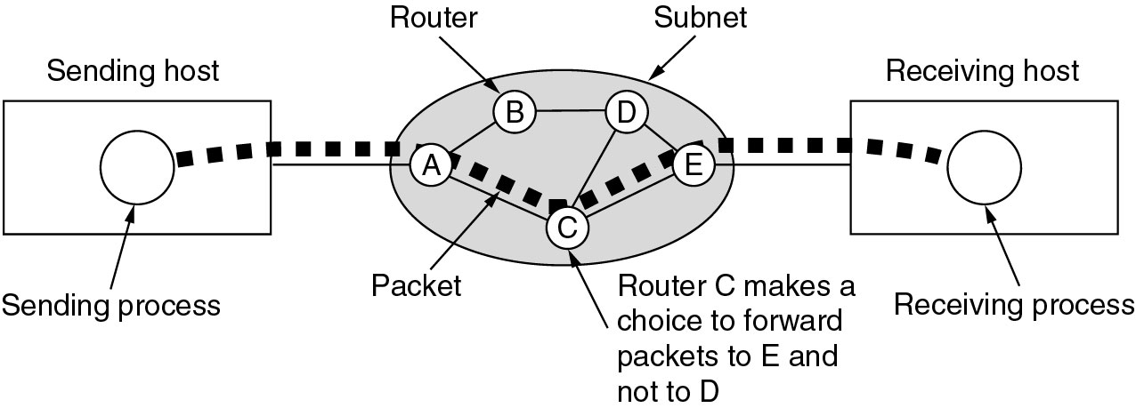
Wide Area Networks (2)
A stream of packets from sender to receiver.

Slide 18
Wide Area Network
Store and Forward or Packet-Switched
When a packet is sent from one router to the other via one or more intermediate router in its entirety, stored there until the required output is free.
Message divided into packets
Satellite connection

Slide 19
Wireless Networks
Categories of wireless networks:
System interconnection
Wireless LANs
Wireless WANs

Slide 20
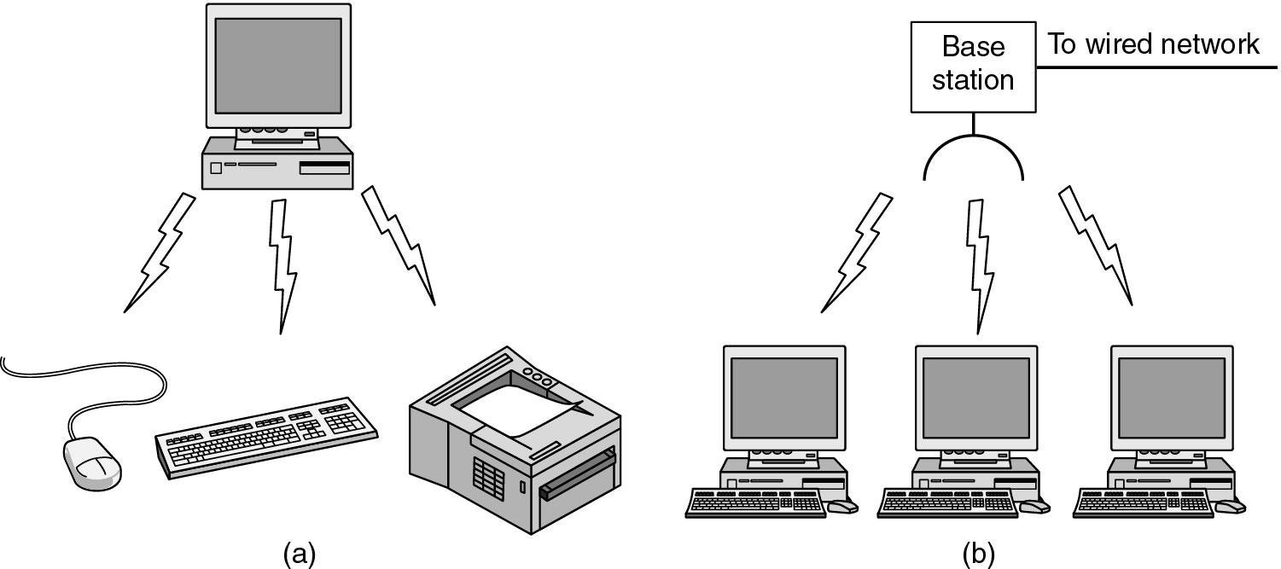
Wireless Networks (2)
        Bluetooth configuration
  Master Slave Paradigm – Master tells the slave what address to use what frequency they can use and when they can broadcast

Slide 21
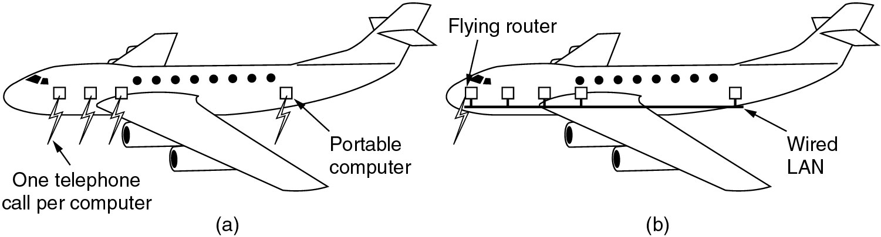
Wireless Networks (3)
Wireless LAN – 802.11
(a) Individual mobile computers
(b) A flying LAN

Slide 22
Wireless WAN
3G Cellular Network – both voice and data (low-speed network)

Slide 23
Home Network Categories
Computers (desktop PC, PDA, shared peripherals
Entertainment (TV, DVD, VCR, camera, stereo, MP3)
Telecomm (telephone, cell phone, intercom, fax)
Appliances (microwave, fridge, clock, furnace, airco)
Telemetry (utility meter, burglar alarm, babycam).

Slide 24
Features of Home Network
Network and devices have to be easy to install
Read the Manual
Reboot the computer
Remove all the hardware and software except ours and try again
Download Newest driver
Reformat the harddisk
Networks and Devices have to be foolproof in operation
(no big manuals)
Low Price (will pay a little extra at most)

Slide 25
Features of Home Network
Main application is likely to involve multimedia, so the network needs sufficient capacity
Possible to start out with one or two devices and expand the reach
Security and reliability will be very important
Burglars disarm ones security

Slide 26
Internetworks
Some LANS connected through WANS
Distinct networks are connected

Slide 27
Network Software
Protocol Hierarchies
Design Issues for the Layers
Connection-Oriented and Connectionless Services
Service Primitives
The Relationship of Services to Protocols

Slide 28
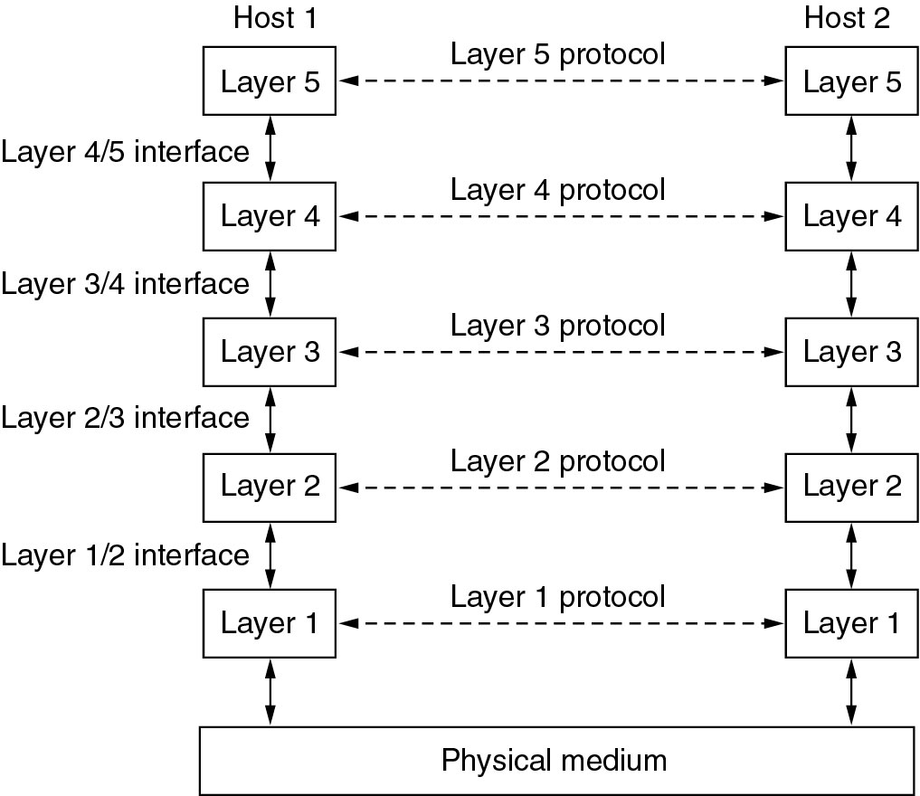
Network Software
Protocol Hierarchies
Layers, protocols, and interfaces.

Slide 29
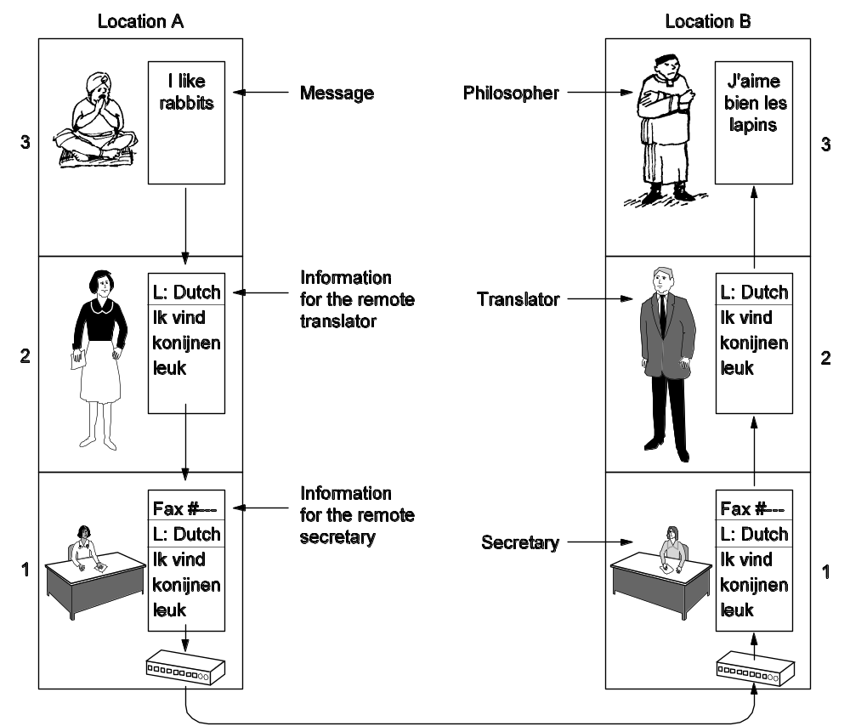
Protocol Hierarchies (2)
The philosopher-translator-secretary architecture.

Slide 30
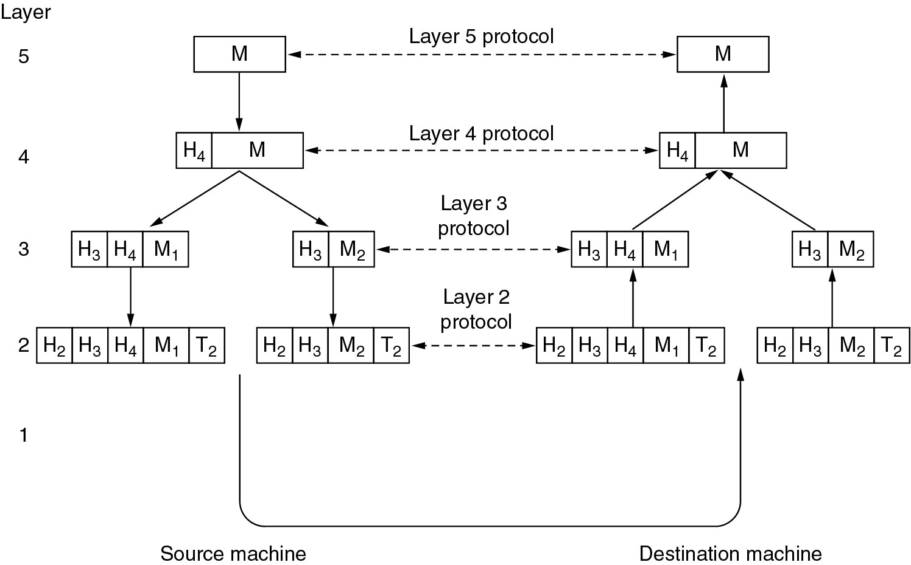
Protocol Hierarchies (3)
Example information flow supporting virtual communication in layer 5.

Slide 31
Design Issues for the Layers
Addressing
Error Control
Flow Control
Multiplexing
Routing

Slide 32
Connection-Oriented and Connectionless Services
Connection – oriented (telephonic system)
Sender, receiver and subnet needs to have a negotiation about the parameters to be used such as maximum message size, quality of services required and other issues
Connection-less (postal service)
Quality of Service

Slide 33
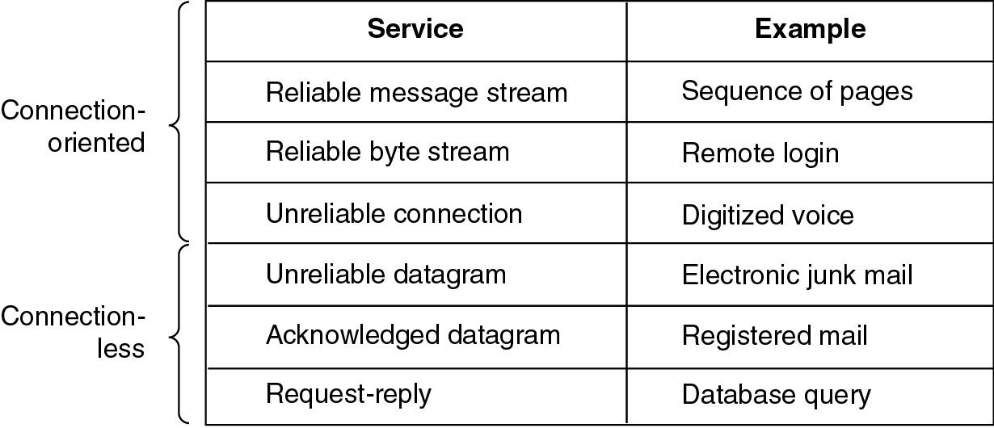
Connection-Oriented and Connectionless Services
Six different types of service.
Notes:
Request-reply – Client issues request, server answers.

Slide 34
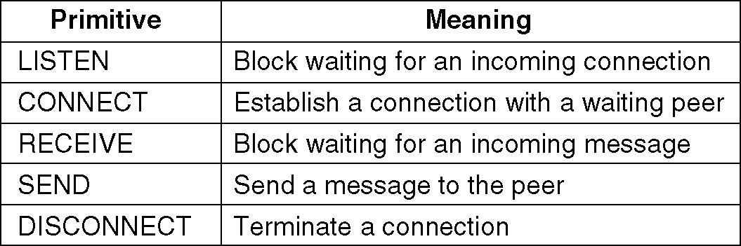
Service Primitives
Listen – server, Connect – client to server and then connection is established
Five service primitives for implementing a simple connection-oriented service.

Slide 35
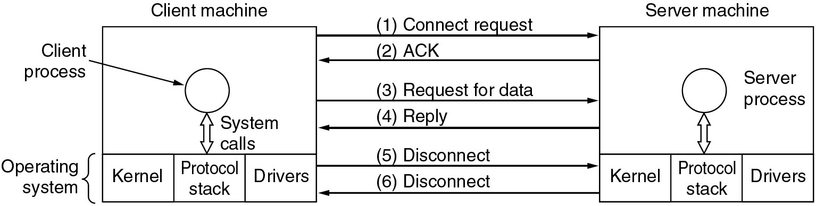
Service Primitives (2)
Packets sent in a simple client-server interaction on a connection-oriented network.

Slide 36
Difficulties
Unreliable networks
Synchronization problem

Slide 37
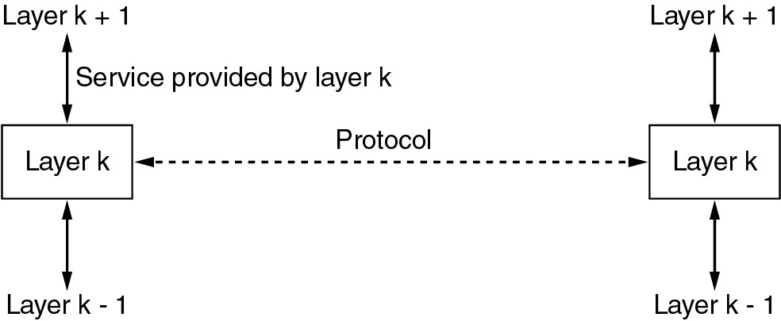
Services to Protocols Relationship
Service – Abstract Data Type or an object in an object-oriented language
The relationship between a service and a protocol.

